Slide 1
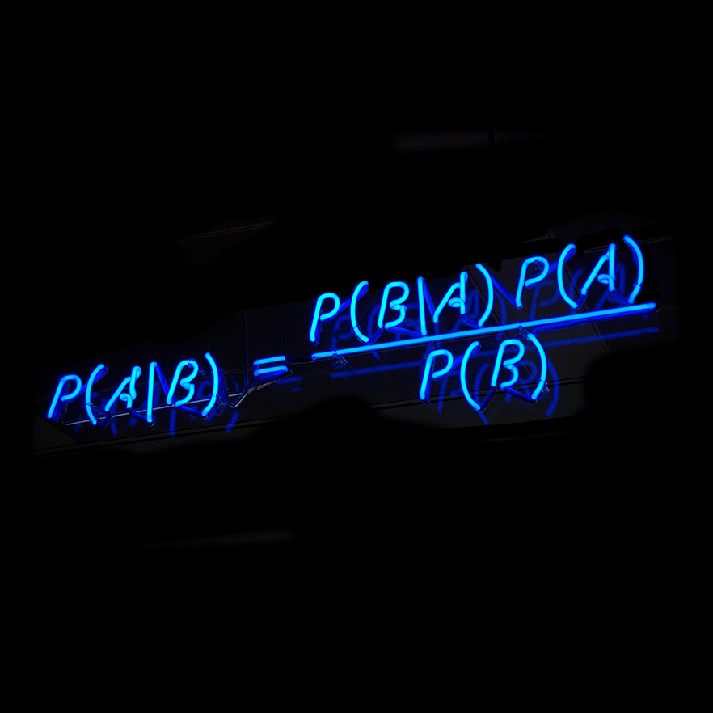
Bayesian Data Analysis in R

Slide 2
Welcome

Slide 3

Overview
Bayesian Statistics
The BayesFactor package
ANOVAs
Linear regression models
Mixed effects models with brms
Specifying custom models with JAGS

Slide 4


Slide 5
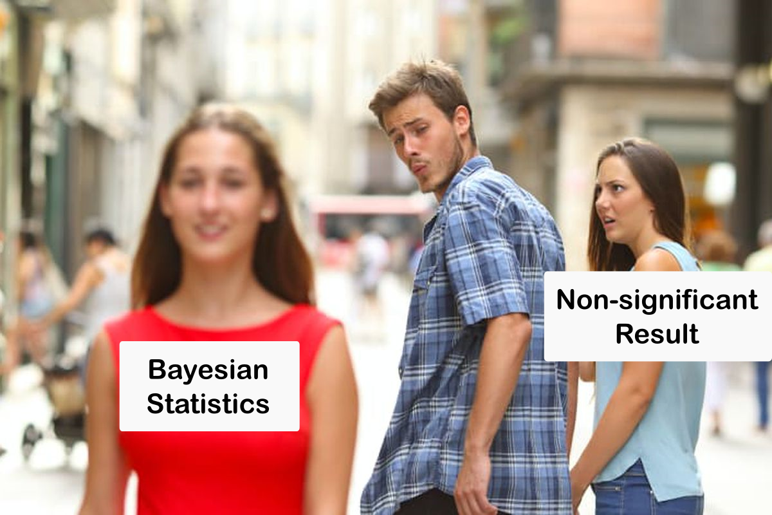

Slide 6
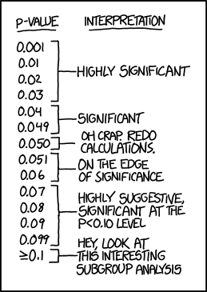

Slide 7
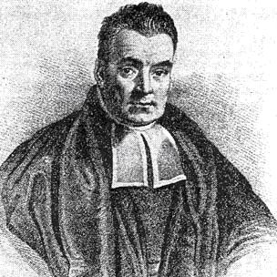
Introduction to (Bayesian) Statistics
Bayesian Reasoning

Slide 8
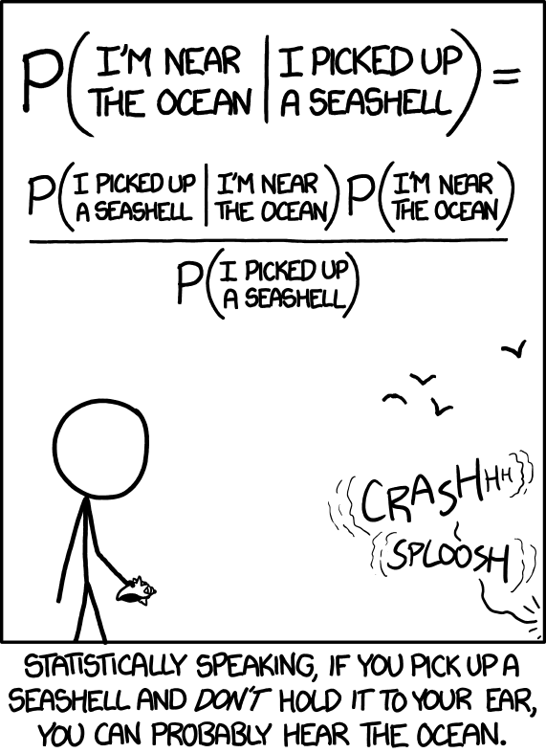
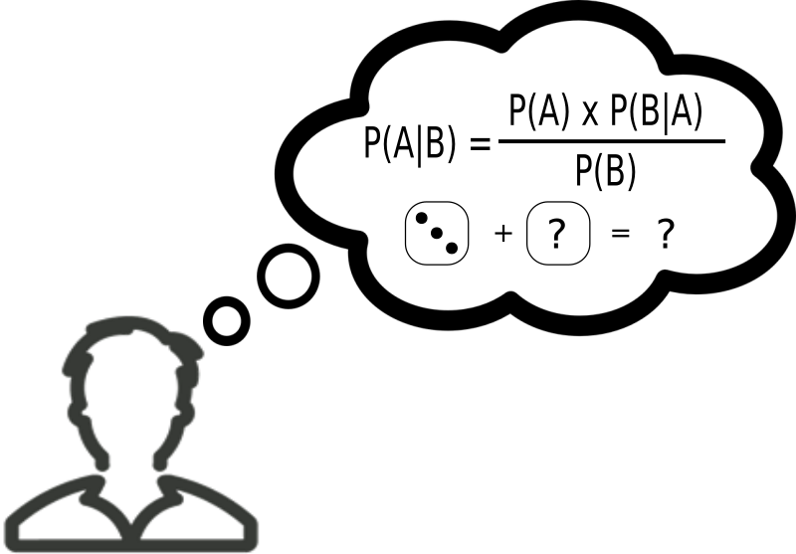
Bayes’ Rule
Bayes’ rule is a fact that all probabilities must obey.
What does this have to do with Bayesian statistics?
We get Bayesian statistics if we combine this rule with Bayesian probability.

Slide 9
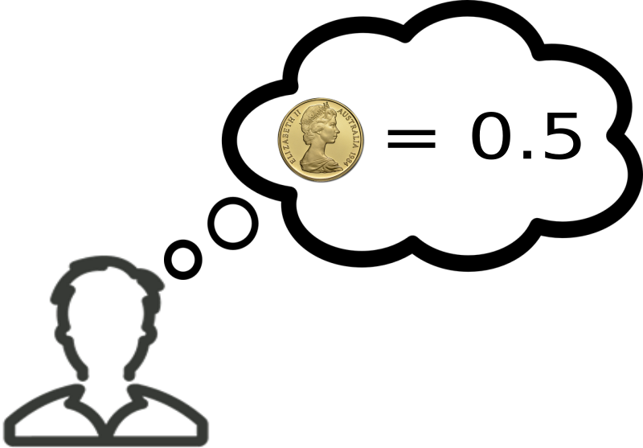

Hypotheses and Data
H: A hypothesis about a coin.
D: An experiment providing some data

Slide 10



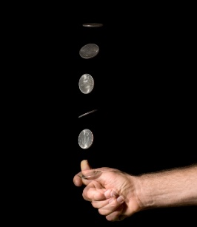
Hypotheses and Data
How much do I believe my
initial hypothesis …
= 0.5
.. given that I just observed
6 heads and 4 tails?

Slide 11
The posterior
= 0.5
The posterior probability that the hypothesis
is true, given that I have observed the data.
P(H)
X
P(D|H)
P(H|D)
=
P(D)

Slide 12
The prior
= 0.5
The prior probability that I observed to the hypothesis,
Before seeing the data.
P(H)
X
P(D|H)
P(H|D)
=
P(D)

Slide 13
The likelihood
The probability that I would have observed
the data if the hypothesis is true, i.e. the
likelihood of the hypothesis.
= 0.5
P(H)
X
P(D|H)
P(H|D)
=
P(D)

Slide 14
The marginal
P(H)
X
P(D|H)
P(H|D)
=
P(D)
The marginal probability that I would observe
the data at all, regardless of which hypothesis is true.

Slide 15
Likelihoods and Bayes Factors

Slide 16
Using data to revise beliefs
P(H): The prior. My belief in the hypothesis
before seeing the data.
P(D|H): The likelihood. The probability
of observing the data if my hypothesis is true.
P(H|D): The posterior. My
revised belief in the hypothesis
after seeing the data.
P(H)
X
P(D|H)
P(H|D)
=
P(D)
P(D): The marginal likelihood.
The probability of observing the data,
regardless which hypothesis is true.

Slide 17
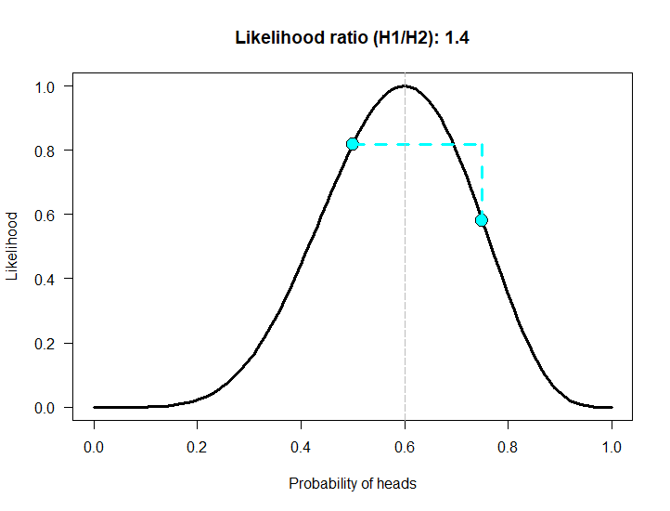
Using likelihood ratios
Comparing the evidence for two models
The likelihood quantifies the evidence the observed data provide for a hypothesis.
Compare the likelihoods of two competing hypotheses to determine which one is more likely (given the observed data).
Value of likelihood is meaningless by itself.
https://humburg.shinyapps.io/likelihood/
Figure based on https://alexanderetz.com/2015/04/15/understanding-bayes-a-look-at-the-likelihood/

Slide 18
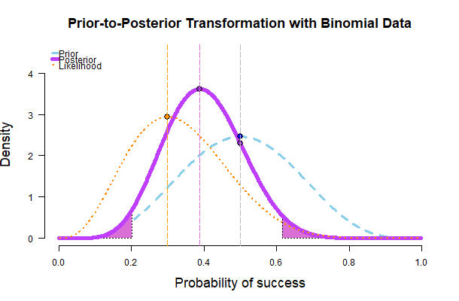
Updating priors with likelihoods
Prior encodes initial belief in possible parameter values (probability of Heads)
Likelihood quantifies the plausibility of different hypotheses in light of the available data.
The two combine to produce an updated set of beliefs, the posterior.
https://humburg.shinyapps.io/updating_prior/
Figure based on https://alexanderetz.com/2015/04/15/understanding-bayes-a-look-at-the-likelihood/

Slide 19
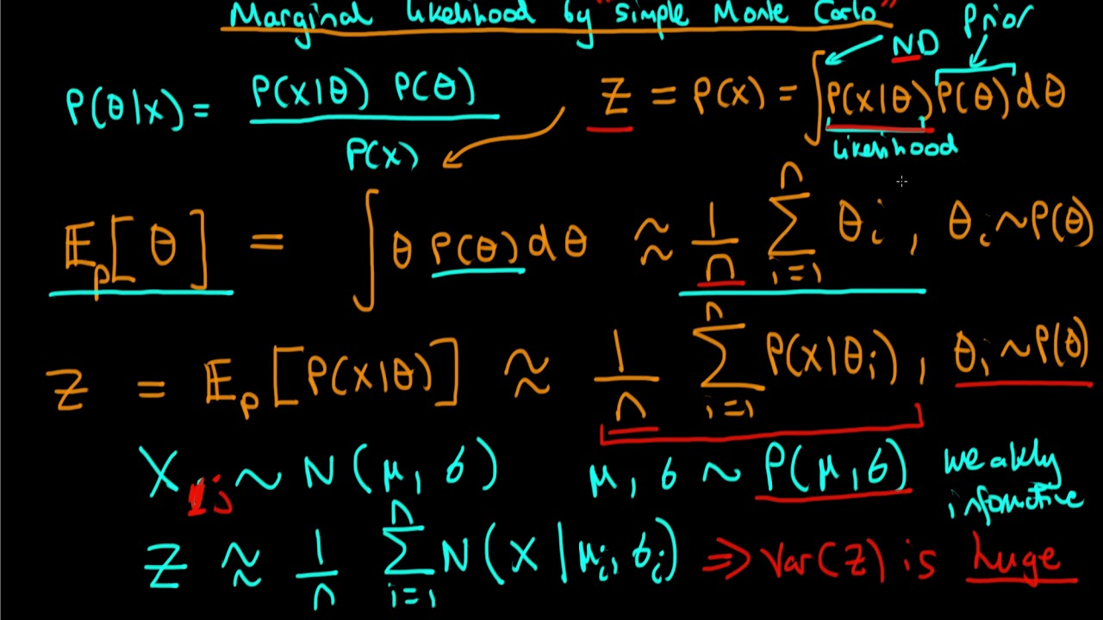
What about the marginal likelihood?
Can be difficult to compute.
Requires integrating over all possible hypotheses, weighted by their priors.
It is a normalizing constant that can often be avoided.

Slide 20
Bayes Factor
The likelihood ratio compares two point hypotheses.
What if we have more complex hypotheses?
Figure based on https://alexanderetz.com/2015/08/09/understanding-bayes-visualization-of-bf/

Slide 21
Bayes Factor
The likelihood ratio compares two point hypotheses.
What if we have more complex hypotheses?
The coin is fair vs it isn’t fair
If the coin is biased, how likely are all the possible probabilities for heads?
Compare the likelihood that the coin is fair to the average of the likelihoods corresponding to all possible values of P(heads) weighted by their priors.
https://humburg.shinyapps.io/bayes_factor/
Figure taken from https://alexanderetz.com/2015/08/09/understanding-bayes-visualization-of-bf/

Slide 22
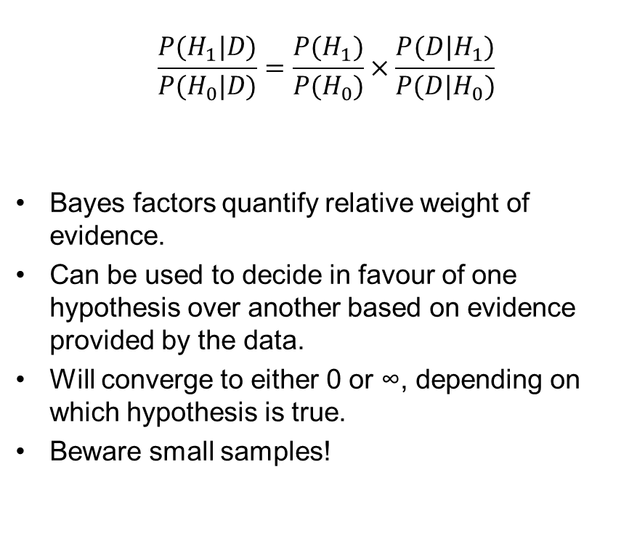
Bayes Factor
$$\frac{P(H_{1}|D)}{P(H_{0}|D)}=\frac{P(H_{1})}{P(H_{0})}×\frac{P({D|H}_{1})}{P({D|H}_{0})}$$
Bayes factors quantify relative weight of evidence.
Can be used to decide in favour of one hypothesis over another based on evidence provided by the data.
Will converge to either 0 or ∞, depending on which hypothesis is true.
Beware small samples!
Bayes Factor (H1/H0) | Strength of evidence
< 1 | Evidence favours null
1 - 3 | Barely worth mentioning
3 - 10 | Substantial
10 - 30 | Strong
30 - 100 | Very strong
> 100 | Decisive
Does this remind you of anything?

Slide 23
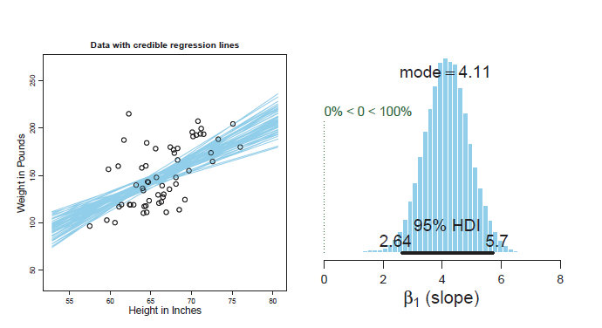
Beyond Bayes Factors
Point estimates and Credible intervals
Bayes factors summarise evidence in support of two competing models.
The posterior holds information about plausible parameter values.
The posterior can tell us what effects are credible after considering the data.
Can construct credible intervals that include 95% of the probability mass such that all values within the interval have higher density than those outside (HDI).
The mode of the posterior provides a point estimate (MAP).
Kruschke, J. K. (2014). Doing Bayesian Data Analysis: A Tutorial with R, JAGS, and Stan. 2nd Edition. Academic Press / Elsevier.

Slide 24
The BayesFactor package
Bayesian Hypothesis Testing with R

Slide 25
Before we get started
Ensure you have these R packages installed
BayesFactor
brms
rjags
HDInterval
All datasets are available from https://humburg.github.io/bayesian-data-analysis-in-r/data.html

Slide 26
BayesFactor Overview
Provides a convenient interface for commonly used models
Bayesian versions of typical frequentist tests
Computes Bayes factors
Can sample from the posterior to obtain parameter estimates
> library(BayesFactor)
> bf <- ttestBF()
> bf <- anovaBF()
> bf <- lmBF()
...
> summary(posterior(bf))

Slide 27
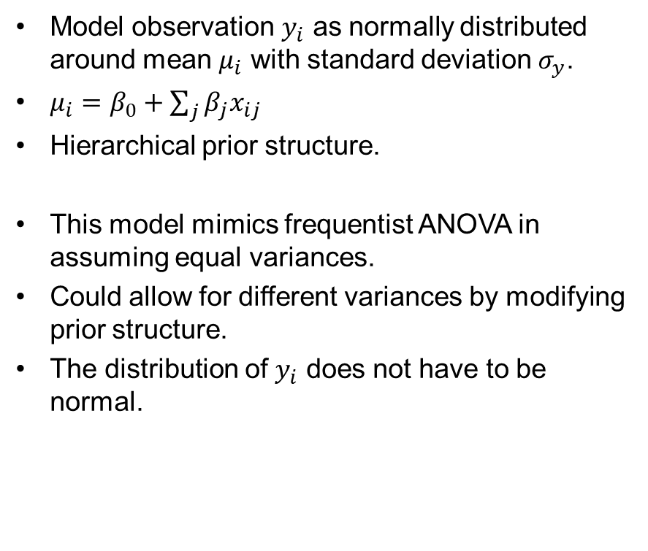
Bayesian ANOVA
General Concepts
Model observation $y_{i}$ as normally distributed around mean $μ_{i}$ with standard deviation $σ_{y}$.
$μ_{i}=β_{0}+\sum_{j}{β_{j}x_{ij}}$
Hierarchical prior structure.
This model mimics frequentist ANOVA in assuming equal variances.
Could allow for different variances by modifying prior structure.
The distribution of $y_{i}$ does not have to be normal.
Copyright © Kruschke, J. K. (2014). Doing Bayesian Data Analysis: A Tutorial with R, JAGS, and Stan. 2nd Edition. Academic Press / Elsevier.

Slide 28
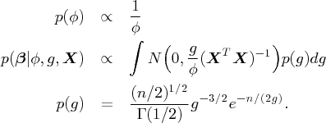
BayesFactor ANOVA
JZS model
Standard approach developed by Jeffreys, Zellner, and Siow.
Allows for heterogeneous variances.
Value of g can be estimated from the data.
No analytical solution for Bayes factor.
Numeric approximation relatively easy.
Example data: https://humburg.github.io/bayesian-data-analysis-in-r/data/anova_data.csv

Slide 29

Let’s try this

Slide 30

Linear Regression
General Concepts
Model observation $y_{i}$ as distributed around mean $μ_{i}$ with standard deviation $σ_{y}$.
Can use t distribution to increase robustness towards outliers.
Use of hyper prior on slope coefficients.

Slide 31
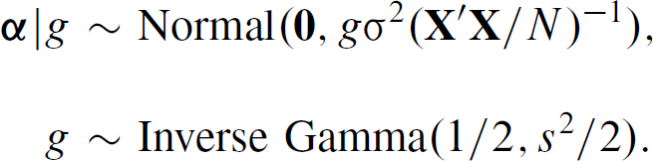
Linear Regression with BayesFactor
JZS
Standard approach developed by Jeffreys, Zellner, and Siow.
Models variance of slope coefficients as Inverse Gamma.
Example data:
https://humburg.github.io/bayesian-data-analysis-in-r/data/regression_data.csv

Slide 32
Let’s try this

Slide 33
Exercise: Weight and Height
Weight (lbs) and height (in) of 14 – 20 year olds.
Take a look at the data.
Use BayesFactor to model weight as a function of height, age, and gender.
Which model seems reasonable?
What are the effects of the variables you included in the model?
Dataset
https://humburg.github.io/bayesian-data-analysis-in-r/data/weight_perception.csv

Slide 34
The brms package
Bayesian mixed effect models

Slide 35
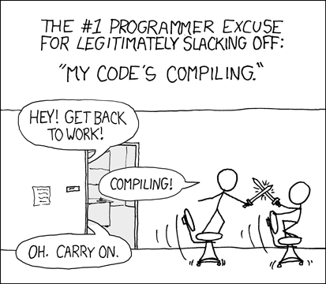

brms Overview
Designed to fit mixed models.
Supports variety of response distributions.
Uses formula syntax similar to lme4.
Models require compilation (slow).
Can avoid repeated compilation with update().
Sampling required to approximate posterior may be slow.
Use multiple cores as appropriate.
https://github.com/paul-buerkner/brms
https://xkcd.com/303/

Slide 36

Accuracy & Reaction Time
An Example
Simulated data of reaction time and accuracy.
16 participants provide 100 responses each.
Single condition.
Can model this as mixed effects logistic regression.
Could fit this with lme4.
Dataset:
https://humburg.github.io/bayesian-data-analysis-in-r/data/mixed_sim1.csv
$$Resp\sim RT+\left(1 | Sbj\right)$$
Or
$$Resp\sim RT+(RT|Sbj)$$
D.J. Davidson, A.E. Martin, Modeling accuracy as a function of response time with the generalized linear mixed effects model,
Acta Psychologica, 144:1 (2013).

Slide 37
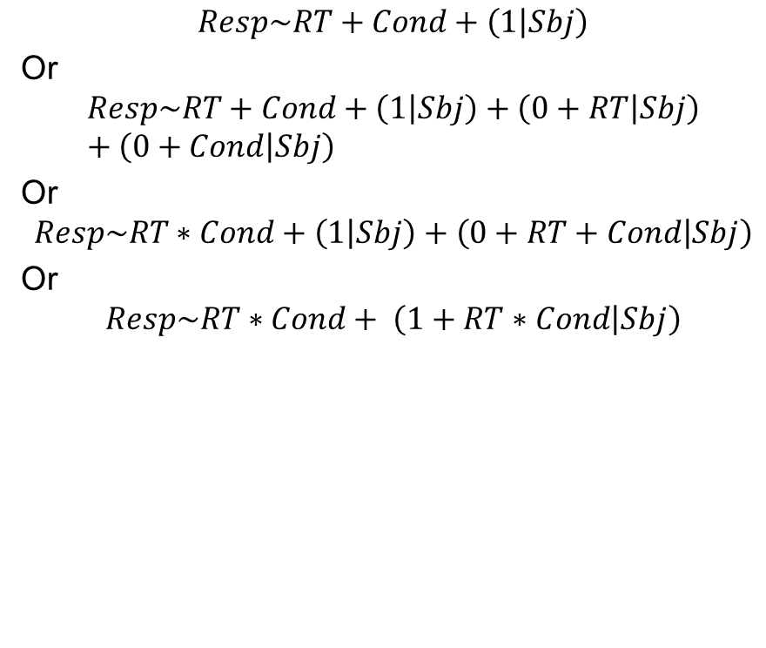
Exercise: Accuracy & Reaction Time
Simulated data of reaction time and accuracy.
16 participants provide 100 responses each.
Two conditions.
Can model this as mixed effects logistic regression.
Could fit this with lme4.
Dataset:
https://humburg.github.io/bayesian-data-analysis-in-r/data/mixed_sim2.csv
$$Resp\sim RT+Cond+\left(1 | Sbj\right)$$
Or
$$Resp\sim RT+Cond+\left(1 | Sbj\right)+\left(0+RT | Sbj\right)+\left(0+Cond | Sbj\right)$$
Or
$$Resp\sim RT∗Cond+\left(1 | Sbj\right)+\left(0+RT+Cond | Sbj\right)$$
Or
$$Resp\sim RT∗Cond+ \left(1+RT∗Cond | Sbj\right)$$
D.J. Davidson, A.E. Martin, Modeling accuracy as a function of response time with the generalized linear mixed effects model,
Acta Psychologica, 144:1 (2013).

Slide 38
Specifying your own models
Describing models with JAGS

Slide 39
What if you want a different model?
Don’t have to use pre-defined classes of models.
Can use jags or stan to specify models directly.
Lots of flexibility.
May take some getting used to.
Jags uses language very similar to R.
Can interact with jags via rjags package.

Slide 40
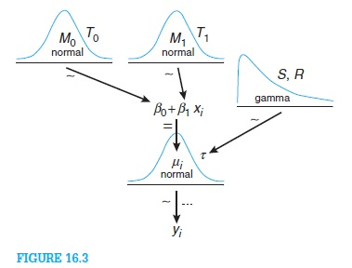
Example: linear regression with JAGS
Use same data as before:
https://humburg.github.io/bayesian-data-analysis-in-r/data/regression_data.csv
Fit simple model including only treatment effect.

Slide 41
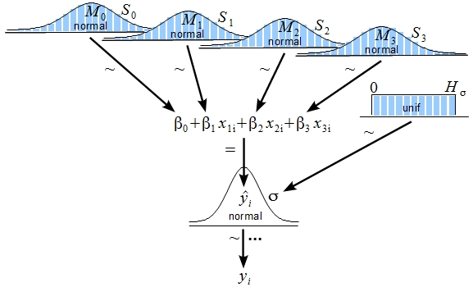
Exercise: Linear regression with JAGS
Continuing from previous example, add the covariate to the model.
Start with separate priors for each coefficient.
What happens if you use a single prior with priors on its parameters instead?

Slide 42
Where to go from here?

Slide 43
Next steps
Try to apply this to your own data.
Simulations can be instructive.
Further reading:
More about brms: https://paul-buerkner.github.io/blog/brms-blogposts/
Andrew Gelman’s blog: https://andrewgelman.com/
John Kruschke’s blog: http://doingbayesiandataanalysis.blogspot.com/

Slide 44
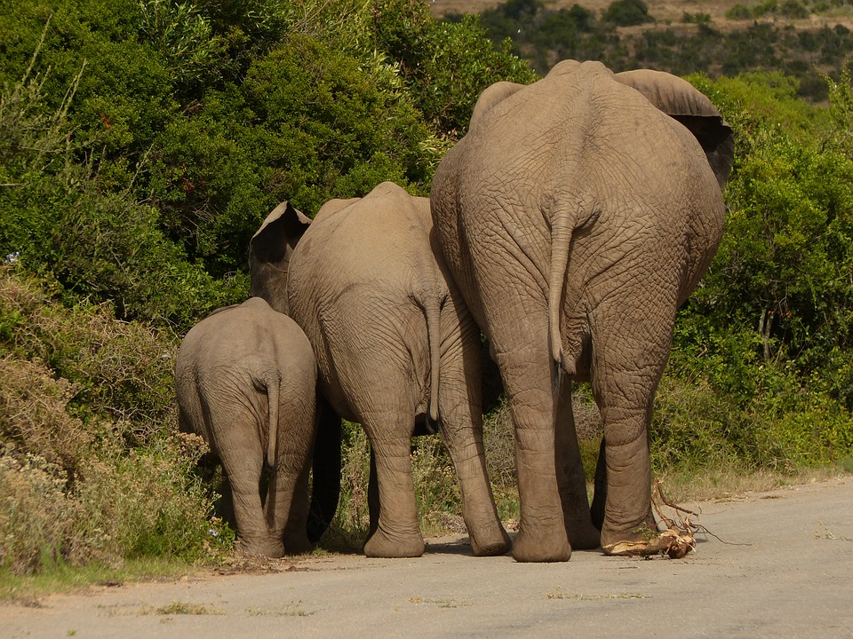
May all your posteriors be large.

